Slide 1








Movie Database General Assembly Final Project
Kate Benjamin

Slide 2
Goals for Final Project
I am addressing a data-related project in my field of work.
My data is from Box Office Mojo (http://www.boxofficemojo.com/)
My datasets include “Average Gross Per Theatre from 1980-2014” “ Average Ticket Price from 1980-2014,” “Movie Release by Season from 1980-2014,” “Studio Makeup by Year from 1980-2014,” and my largest and most valuable one, “Yearly Movie Gross from 1980-2014.”
My dataset “Yearly Movie Gross from 1980-2014” includes 13,113 movie title releases from 1980-2014. I ranked them by year and total gross. Included in the data is studio, total gross, opening week gross, opening day and gross per theatre. I created a new feature “2014 dollars.” This is the amount the movie would have made if it were released in 2014.
Using linear regression, I will predict the total gross of movies from 2000 to 2014 using opening week performance and the number of theatres it played in. I will then add in the studio name and year as new features to see if my prediction score becomes more accurate. I will continue to add new features to see if my score gets stronger.
This summer, my team and I plan to update this dataset to include movies from 2015.

Slide 3
American Sniper was the highest grossing movie of 2014.
Rank | Studio | Movie Title | Total Gross | Opening | Theatres | Gross Per Theater
1 | WB | American Sniper | $337,209,000 | $633,456 | 3,885 | $86,798
2 | LGF | The Hunger Games: Mocking jay - Part 1 | $336,962,000 | $121,897,634 | 4,151 | $81,176
3 | BV | Guardians of the Galaxy | $333,176,600 | $94,320,883 | 4,088 | $81,501
4 | BV | Captain America: The Winter Soldier | $259,766,572 | $95,023,721 | 3,938 | $65,964
5 | WB | The LEGO Movie | $257,760,692 | $69,050,279 | 3,890 | $66,262
6 | WB | The Hobbit: The Battle of the Five Armies | $251,678,000 | $54,724,334 | 3,875 | $64,949
7 | Par. | Transformers: Age of Extinction | $245,439,076 | $100,038,390 | 4,233 | $57,982
8 | BV | Maleficent | $241,410,378 | $69,431,298 | 3,948 | $61,148
9 | Fox | X-Men: Days of Future Past | $233,921,534 | $90,823,660 | 4,001 | $58,466
10 | BV | Big Hero 6 | $218,056,000 | $56,215,889 | 3,773 | $57,794
11 | Fox | Dawn of the Planet of the Apes | $208,545,589 | $72,611,427 | 3,969 | $52,544
12 | Sony | The Amazing Spider-Man 2 | $202,853,933 | $91,608,337 | 4,324 | $46,913
13 | WB | Godzilla (2014) | $200,676,069 | $93,188,384 | 3,952 | $50,778
14 | Sony | 22 Jump Street | $191,719,337 | $57,071,445 | 3,426 | $55,960
15 | Par. | Teenage Mutant Ninja Turtles (2014) | $191,204,754 | $65,575,105 | 3,980 | $48,041
16 | Par. | Interstellar | $186,666,000 | $47,510,360 | 3,561 | $52,420
17 | Fox | How to Train Your Dragon 2 | $177,002,924 | $49,451,322 | 4,268 | $41,472
18 | Fox | Gone Girl | $167,628,577 | $37,513,109 | 3,284 | $51,044
19 | LG/S | Divergent | $150,947,895 | $54,607,747 | 3,936 | $38,351
20 | Uni. | Neighbors | $150,157,400 | $49,033,915 | 3,311 | $45,351
Source: Box Office Mojo

Slide 4
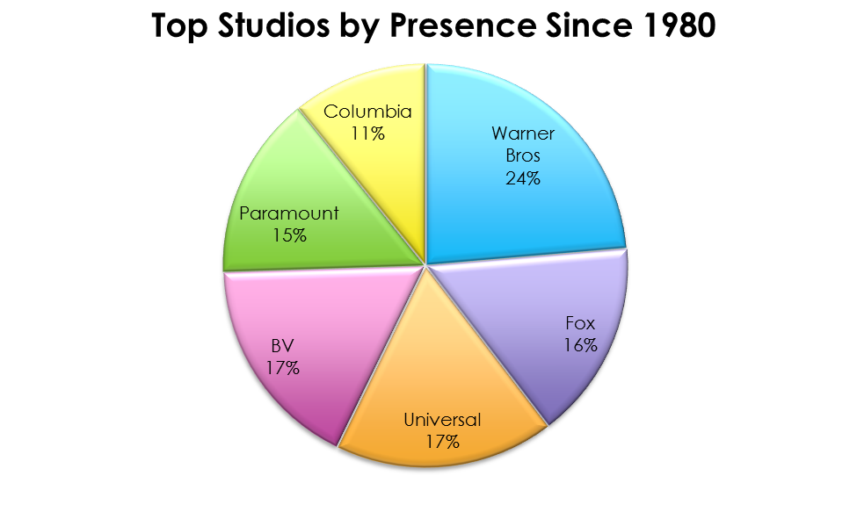


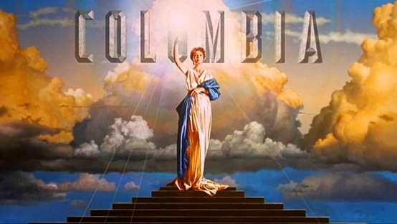

Since 1980, Warner Brothers has produced roughly ¼ of all new movies, in comparison to other top studios.
Source: Box Office Mojo

Slide 5
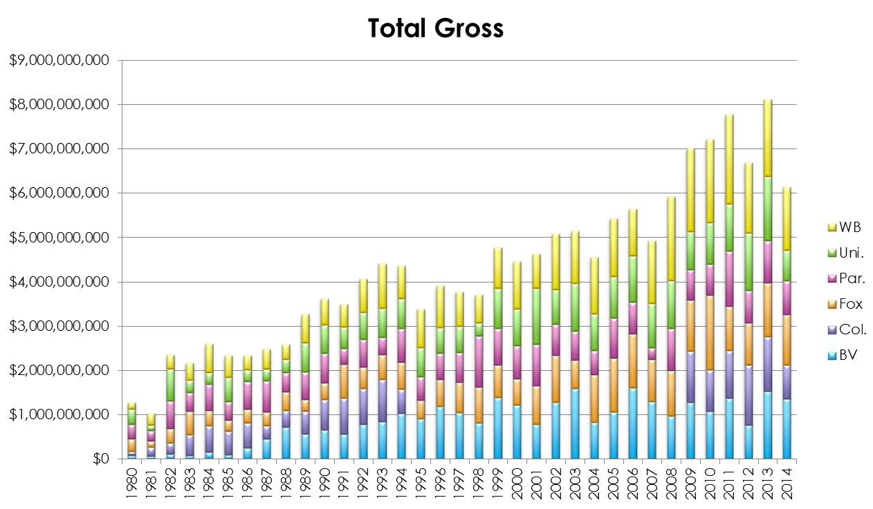
2013 was the highest grossing year for new movies, while 2012 and 2014 were unusually low.
Source: Box Office Mojo
Data unavailable for Columbia Pictures 1995 to 2008.
BV (Buena Vista) stands for Walt Disney

Slide 6
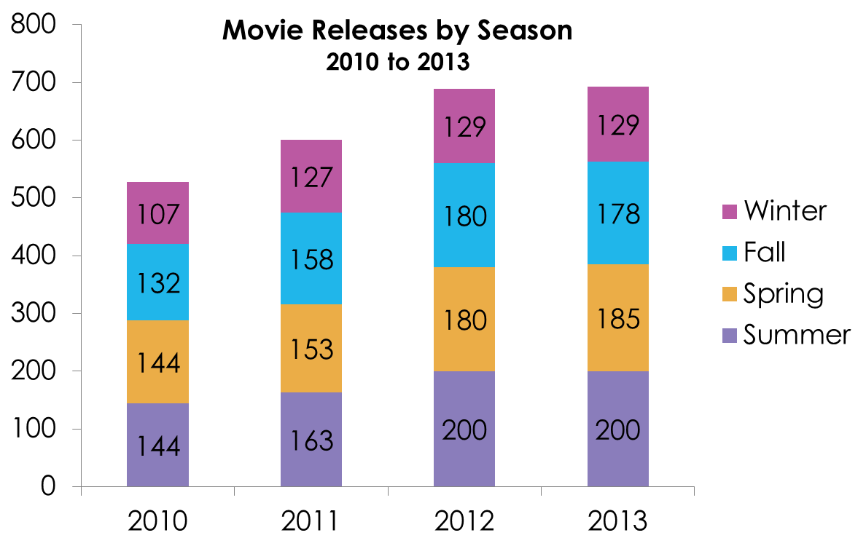
Summer months tend to be the most popular time for new movie releases, while the winter sees a significant drop.
Source: Box Office Mojo

Slide 7
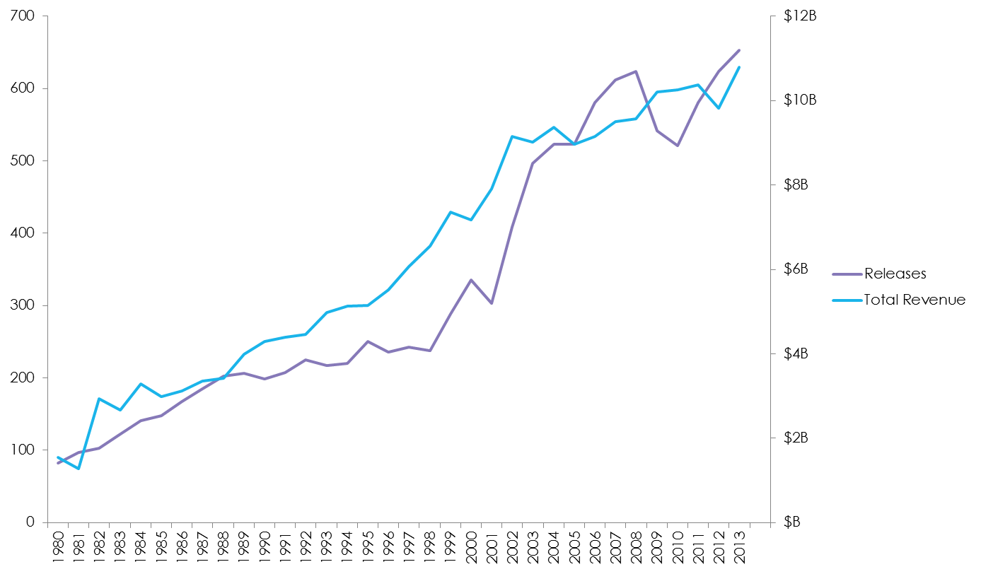
While the number of new movies released from 2008 to 2010 dropped significantly, total revenue was not impacted.
Source: Box Office Mojo
Data unavailable for 2014.

Slide 8
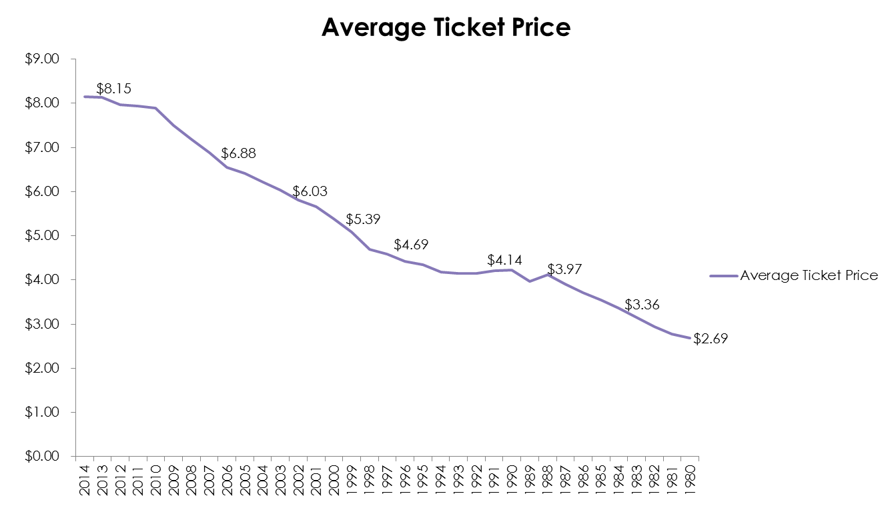
The average movie ticket price went up +203% from 1980 to 2014.
1980
$2.69
2000
$5.39
2014
$8.15
Source: Box Office Mojo

Slide 9
Using Linear Regression, my model was 92% accurate.
Using Linear Regression, my model was 86% to 92% accurate, depending on my features.
When I predicted total gross using just opening week gross and length of weeks the movie was in theaters for my model was 86% accurate.
When I predicted total gross using opening week gross, amount of theaters played in and year my model was 86% accurate.
Then I added in “weekly information” I had. When I predicted total gross using opening gross, theaters, year, gross per week, amount of week movie was number 1, and the length of weeks the movie was in theaters my model was 89% accurate.
When I added movie rank for the year, amount of theaters it opened in, and gross per theater my model was 92% accurate.
Note: amount of theaters played in and amount of theaters opened in are different
I decided to not take into consideration studio name, quarter fiscal year and opening and closing dates. I’m sure my model would have been even more accurate with opening and closing dates (summer hits for example) but there was too much missing data for the feature for it to be reliable.
The opening weekly gross and the length of weeks the movie was in theaters for were in my opinion the best indicator in predicting the total gross of a movie.

Slide 10
Conclusion
In the future, I would be interested in using a decision tree or random forest to see if my results vary.
Since this is an ongoing project at work, the dataset will be updated to include recent movies.
In the future, I would like to predict total gross based on studio and opening/closing day as well – but right now there is too much missing data in those features, so I had to delete them from my dataset.
The file was also to large for my laptop to include movies from 1980 – 2014, so I would also be interested if you used all of the data how the results would differ.

Slide 11
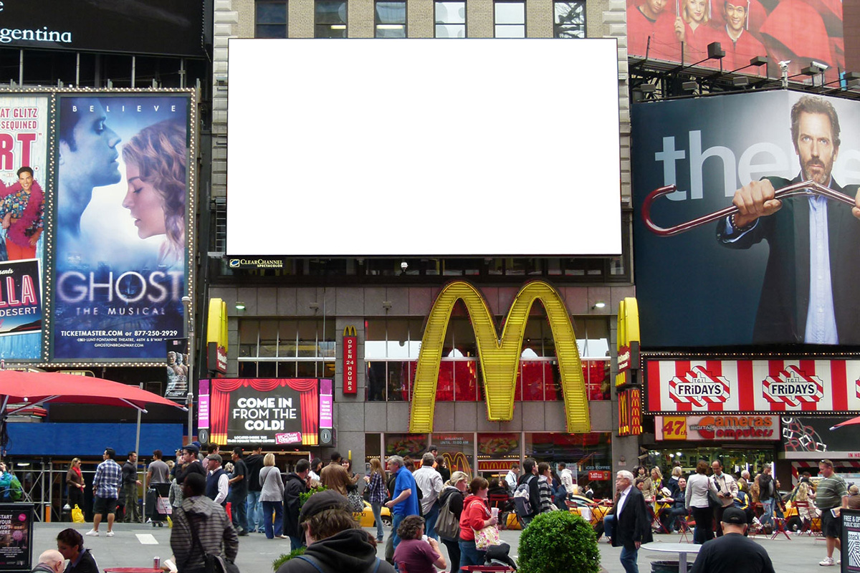
Thank you Mason, Lema and Data Science 30!

